Slide 1
Evidence-Based Management Helping Managers Make Better Decisions
Denise M. Rousseau
HJ Heinz II University Professor
Carnegie Mellon University

Slide 2
What is Evidence-Based Management?
EBMgt is the practice of making organizational decisions based upon conscientious use of
Science-based principles & knowledge
Valid & relevant organizational and business facts
Critical thinking aided by decision supports
Ethical considerations (i.e., effects on stakeholders)

Slide 3
Why Should We Care about EBMgt?
Better Decisions by Using Practices that Work (and avoiding those that don’t!)
Defensible Decisions that Stand Up to Scrutiny (using best evidence and best process)
Developing Expertise throughout a Career (experience can be a poor teacher--bad habits!)
20 years of valid experience is different than 1 year of experience repeated 20 times!

Slide 4
What does EBMgt Look Like?

Slide 5
Evidence-based Piloting?

Slide 6
1. Use of Scientific Findings
Chesley Sullenberger, USAIR pilot, has been a visiting scholar at UC Berkeley’s Collaborative for Catastrophic Risk Management since 2007
Does research on how to make decisions to maintain safety despite technological complexity and crisis conditions

Slide 7
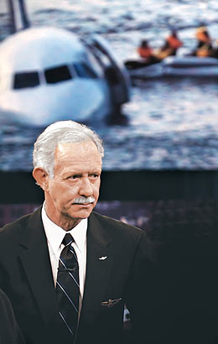
2. Reliance on Reliable and Valid Organizational Facts
Has written and analyzed aviation accident reports for over 20 years

Slide 8
3. Professional Judgment, Critical Thinking and Decision Supports
Formal Education to Prime His Skills: Sully is a graduate of the U.S. Air Force Academy and holds masters degrees from both Purdue University in Industrial Psychology and the University of Northern Colorado in Public Administration
Used Decision Aids to Support Good Decision: As Sully considered what decision to make that day, he had his copilot review and follow all checklists on board relevant to crash landings

Slide 9
4. Ethics and Responsibility to Stakeholders
The last person to leave the plane, Chesley Sullenberger twice walked the plane’s aisle to check all passengers were off
Sully’s last act onboard was to grab the passenger list. Used on-shore to verify rescue of all passengers and crew.
What Sully and co-pilot did NOT talk about

Slide 10
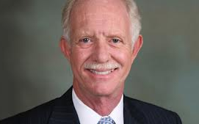
In Sullenberger’s Own Words…
“One way of looking at this might be that
for 42 years, I've been making small,
regular deposits in this bank of experience, education and training.
And on January 15, the balance was sufficient so that I could make a very large withdrawal.”

Slide 11
EBMgt is a means to improve decision quality.
It’s a career, not a course.

Slide 12
EBMgt The Basics of Why and How

Slide 13
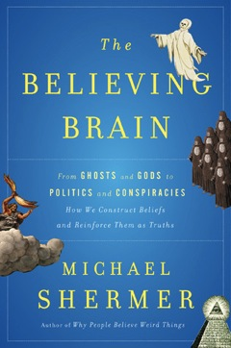
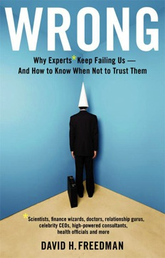
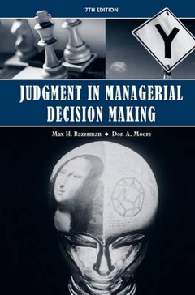
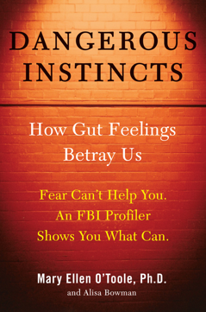
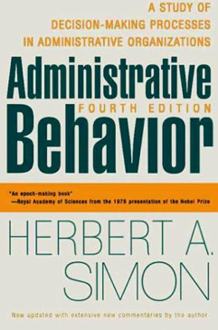
Bounded rationality

Slide 14
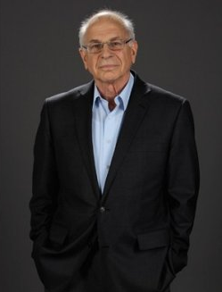
Bounded rationality
System 1
Fast (lazy)
Intuitive, associative
heuristics & biases
System 2
Slow (effortful)
Deliberate, ‘reasoning’
Rational

Slide 15
System 1: prone to biases
Seeing order in randomness
Mental corner cutting
Misinterpretation of incomplete data
Halo effect
False consensus effect
Group think
Self serving bias
Sunk cost fallacy
Cognitive dissonance reduction
Confirmation bias
Authority bias
Small numbers fallacy
In-group bias
Recall bias
Anchoring bias
Inaccurate covariation detection
Distortions due to plausibility

Slide 16
EBMgt Overcomes Limits of Unaided Decisions
Bounded Rationality
The Small Numbers Problem of Individual Experience
Prone to See Patterns Even in Random Data
Critical Thinking
Decision Supports
Research
Large Ns > individual experience
Controls reduce bias
The “Human” Problem
Evidence-Based Practice

Slide 17
EBMgt Overcomes Limits of Unaided Decisions
Bounded Rationality
The Small Numbers Problem of Individual Experience
Prone to See Patterns Even in Random Data
Critical Thinking
Decision Supports
Research
Large Ns > individual experience
Controls reduce bias
The “Human” Problem
Evidence-Based Practice

Slide 18
Good EBMgt Habits & What We Teach
Get Evidence into the Conversation
Obtain & Use Relevant Scientific Evidence
Obtain & Use Relevant, Reliable and Valid Business or Organizational Facts
Evaluate Quality of Practitioner Experience
Reflect on Decision’s Ethical and Stakeholder Implications
Combine Evidence from Different Sources using Decision-Appropriate Processes

Slide 19
Scientific Evidence: Which design for which question?
Explanation

Slide 20
Organizational Evidence
From Data to Knowledge
Organizational
Data
Basic Observations and Numbers in Workflow and Management Data Systems
Unfiltered
Uncorrected for Bias
Unadjusted for Interpretation
Corrected or Adjusted for Interpretation:
Adjusted via base rates, Comparisons over Time or with Controls
Aggregated to improve reliability & validity or avoid small numbers problem (e.g. index, scale)
Filtered or organized for decisions and use
–Broken out by unit or level at which decisions are made
Organizational
Information
Information put in context of use
Quality Indicators shared, reviewed, reflected on regularly
Balanced Scorecard Indicators, examined for trends and predictors.
After Action Reviews to review observations and outcome information; Experiments to test practice interventions/logic
Organizational
Knowledge

Slide 21
Stakeholder Evidence
Key people who influence the decision
OR are affected by the decision
Evidence Quality:
Representative sample of stakeholders
Valid and reliable measures of concerns and interests

Slide 22
Professional Judgment
Evidence Quality: Does the person have valid experience?
Years of experience?
Specific domain where decisions are similar?
Clear feedback regarding results of decisions?
Baker vs orthopedic surgeon vs change manager each with five years of experience.

Slide 23
Follow Up
If interested in learning more….
Contact:
denise@cmu.edu
Check out website of Center for Evidence-Based Management www.cebma.org
Go to our free on-line EBMgt training at oli.cmu.edu Sign in and search “free and open classes” for “Evidence-based Management”

